Slide 1
DynamoDB Immersion Day!
Presenter Name Presenter Title
Date XXth, 20XX

Slide 2
NoSQL Design Patterns for DynamoDB
Notes:
In this session we will focus on a number of design patterns. We will go through these examples to highlight best practices and understand the ‘why of NoSQL data modeling. These examples are useful to understand how to build data models to solve real world problems.

Slide 3





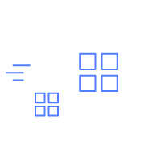
All data is relational
IT monitoring
Social graph
Documents
Auth services
“DynamoDB helps us achieve greater developer efficiency…at a lower cost.”
(Migrated from MongoDB to DynamoDB)
—Jun-young Kwak
Tinder
Notes:
The only data that we are interested in, is data that is related to something. IT monitoring, Social graphs, etc….
Even the “most relational” data - who we are swiping right on…needs to go somewhere
--Tinder migrated to DynamoDB from MongoDB

Slide 4
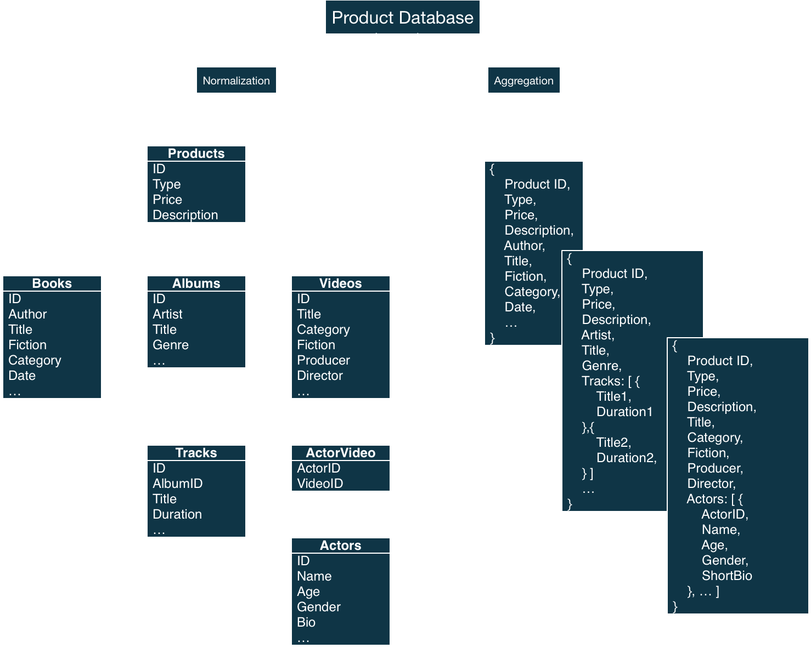
SQL vs. NoSQL design pattern
Notes:
The typical relational model is nicely organized in ‘human readable’ constructs: tables that are related to categories. It is modeled to reduce storage. Storage is cheap, but compute is more expensive.
We step off into the world of aggregated items – essentially prebuilt items. Rather than running queries/joins across tables – these items are written as they will be retrieved. This requires understanding the access patterns and writing the data appropriately, but the benefit is nearly limitless scale and consistent performance.

Slide 5
TENETS OF NoSQL DATA MODELING
Define the use case
Identify the access patterns
Read/Write workloads
Query dimensions
Aggregations
Data-modeling
Avoid relational design patterns
Start with one table
Application type: OLTP vs OLAP
Data Life Cycle:
TTL, Backup/Archival, etc.
Identify Primary Keys
How are inserts and reads?
Overload items into partitions
Review -> Repeat -> Review
Notes:
Working backwards from the access patterns is the mantra of NoSQL data modeling, but there are many workload dimensions that will shape how the choices are actually made.
If it is a write heavy workload, may not necessarily optimize for reads.
Start with one table, this helps break that relational training – but it also helps reduce number of round trips. Try to organize data to be returned as related collections under partition keys.
What is the data life cycle? Can you use DynamoDB for hot/warm data and tier that off for long term storage in S3 using TTL/

Slide 6
Building Queries
Queries: Sort Key Condition vs Filter Expressions Composite Keys: Data Model Fundamentals
Notes:
Building queries means you will write data as you will access it.
We will explore how composite keys are the foundation of building relationships and contrast the Sort Key condition and Query Filters.

Slide 7
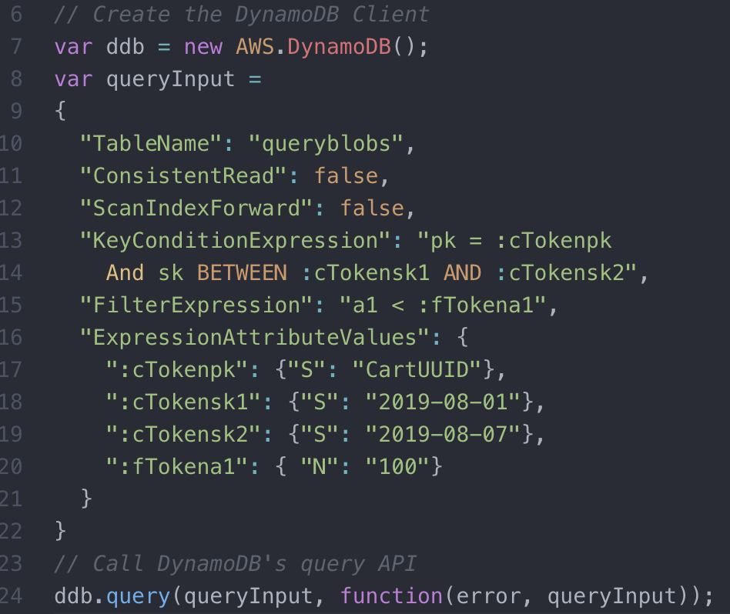
A word on queries…
SELECT * FROM Table WHERE pk = 'CartUUID’ AND sk BETWEEN '2019-08-01' AND '2019-08-07' AND a1 < 100 ORDER BY sk DESC;
Queries return all items as a single response. Supports pagination.
Query require equals on partition key.
Single key condition expression. begins_with, between, =, <, >, <=, and >=
Filter Expression on attribute values. Supports nested values.
REST API syntax – not SQL.
Notes:
We will use SQL like examples, but that is only because it is a common data language we all share. There is ‘no SQL’ for DynamoDB; it is REST api based.
Key Conditions Support: Only applies to sort key – can only have 1 SK condition. begins_with, between, <, >, =, <=, >= limit desc
Note – SK condition does not support: IN, CONTAINS, Ends_With, etc…
Filter Conditions: Applied AFTER the query runs – so it will not change the consumed RCUs. Support filtering on any non-key attribute (and nested attributes). Supports above conditions as well as IN & CONTAIN type conditions.

Slide 8
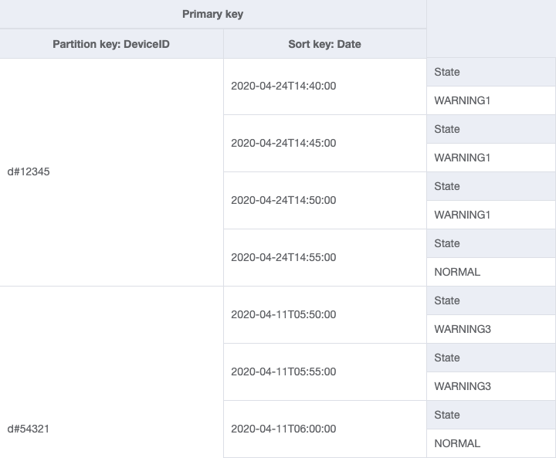
Device Logs: Filter Expressions vs Sort Key Conditions
High cardinality
Sorted by date time
Filter by Status
Notes:
Warm up data modeling example – to understand the difference between Filters & Sort Key conditions.
Imagine an application where devices are sending updates to a table.
The table is organized by DeviceID, so it has a well distributed/high cardinality key space and access pattern. (The number of partition keys will scale out as more traffic and throughput is used by the application) It is sorted by Date – so that queries can return items in most recent order. The combination of the ID and the Date define uniqueness – so in this case, there could be a new log inserted for each device every 5 minutes (this could be more granular).
<Best practices is to use PK & SK for indexes, these are named for clarity in this example>

Slide 9
Access Pattern: Fetch all warning logs for a device that are sorted in descending order
Returned
SELECT * FROM DeviceLog
WHERE DeviceID = ‘d#12345'
ORDER BY Date DESC
FILTER ON State=‘WARNING1'
Filtered
aws dynamodb query
--table-name DeviceLog
--key-condition-expression ”#dID = :dID”
--no-scan-index-forward
--filter-expression "#s = :s”
--expression-attribute-names ‘{“#dID": ”DeviceID”, “#s”: “State}’
--expression-attribute-values ‘{“:dID”: {“S”:”d#12345”}, “:s”: {“S”:”WARNING1”}}’
Notes:
Warm up data modeling example – to understand the difference between Filters & Sort Key conditions.
To retrieve only warning logs with this design, you would query where deviceID = 12345, and then filter out all updates that were normal. Now, this would be okay – but most systems are going have >99% of updates normal and <1% of updates as warning (hopefully!). In this case, when a query is run on 500 items, typically 495 of them will be filtered out and 1% of them will be returned. The filter expression is applied after the query, so DynamoDB will read (and consume) RCUs for all 500 items regardless of whether it returns 5 or 500.
So… can we do better? How could we make this access pattern more efficient?

Slide 10
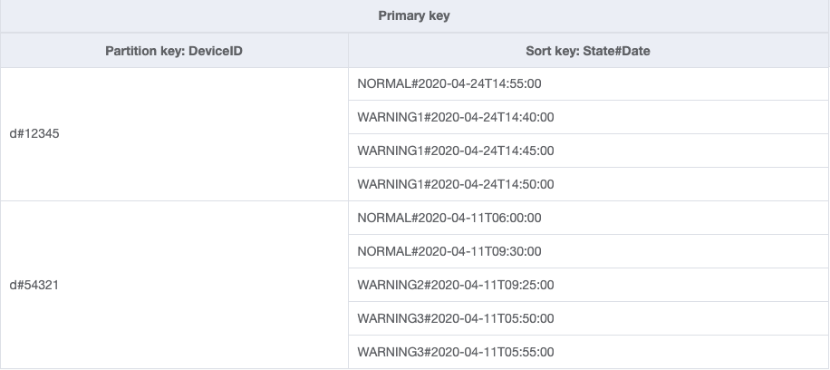
Build Composite Sort Keys to use Sort Key conditions
SELECT * FROM DeviceLog
WHERE DeviceID = ‘d#12345'
ORDER BY Date DESC
BEGINS_WITH
State#Date=‘WARNING1'
aws dynamodb query
--table-name DeviceLog
--no-scan-index-forward
--key-condition-expression ”#dID = :dID AND begins_with(#s, :sd)”
--expression-attribute-names ‘{“#cId": ”DeviceID”, “#s”: “State#Date”}’
--expression-attribute-values ‘{“:cId”: {“S”:”d#12345”}, “:sd”: {“S”:”WARNING1#”}}’
Notes:
Make efficient queries by building data to match access patterns: use “Sort Key Conditions.” Build composite sort keys by concatenating 2 attributes that you are interested in. Use the most general on the left and concatenate the more unique to the right. This enables the ‘begins_with’ condition we will see in a moment…
In this example – we are interested in State and Date – the State is much more general (NORMAL, WARNING1, WARNING2, WARNING3), so it is our leading term in this concatenated attribute.
We now have a new Sort Key – a composite key: State#Date. The application writes this as the sort key.
This fundamentally changes the query. Now, if there were 500 hundred saved items, and this Begins_With query is run – it will read and return ONLY the Warning items. This is how we can create very efficient targeted queries.
A couple additional points:
– Queries always need the full equals on the Partition Key.
-- Queries will return all of the items as a single aggregate. So, if there are 10 items that are 400bytes each (4KB) it would still just consume 1 RCU (4KB).
Great – we’ve built a composite sort key to model multiple query access patterns into a single sort key. There could be many more layers to this hierarchy as long as it fulfills the access pattern. This is a solid 1 to Many relationship. 1 device to many updates – and we now can sort it by status and order it by date. This fulfills the common access patterns of the application for the user.
The result set from a Query is limited to 1 MB per call. You can use the LastEvaluatedKey from the query response to retrieve more results.

Slide 11
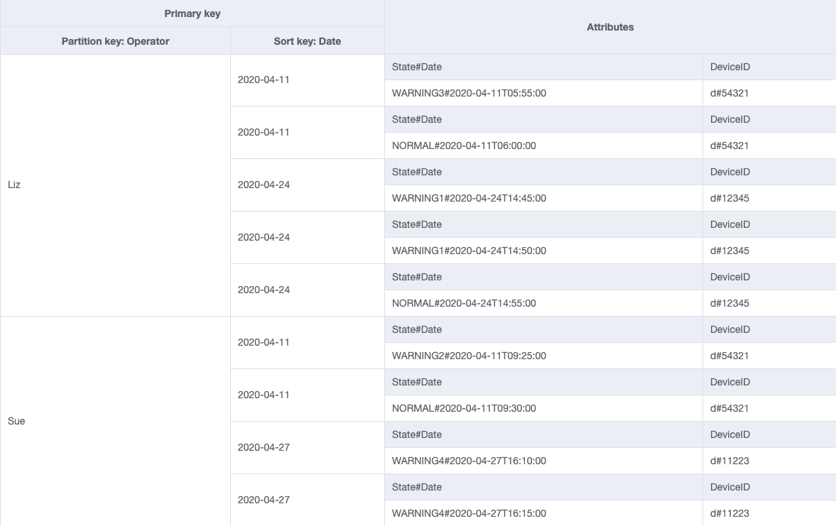
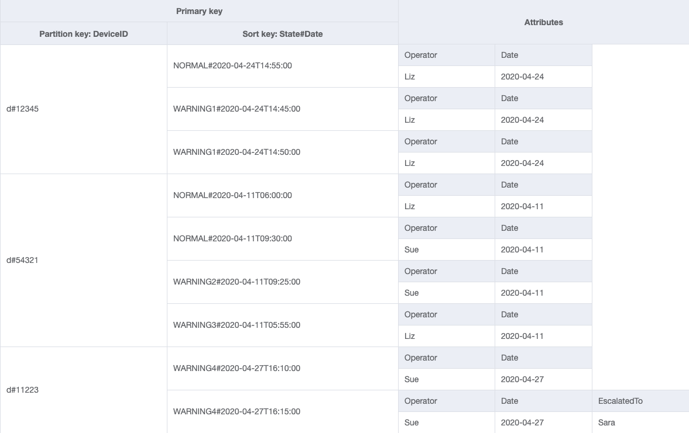
New Access Pattern: Fetch all device logs for a given operator between two dates
GSI-Operator
Base Table
Notes:
What happens when there is a new access pattern? What if the system has a requirement to fetch data logs from an operator between two dates?
By keeping values as top level attributes, you can add a GSI to the table at any time. A GSI is effectively a view or a second table that DynamoDB keeps up to date for you…
Using “Operator” as a GSI-partition key is a good choice here, because it will maintain high cardinality for the pk of the GSI (a requirement just like the base table). By adding this GSI, we are establishing a M:N relationship (many devices : many operators).

Slide 12
Access Pattern: logs for a given operator between two dates
SELECT * FROM GSI–Operator
WHERE Operator = ‘Liz'
ORDER BY Date DESC
BETWEEN
Date=‘2020-04-20’ AND
‘2020-04-25’
GSI – Operator
aws dynamodb query
--table-name DeviceLog
--index-name GSI–Operator
--key-condition-expression ”#op = :op AND #d between :d1 AND :d2”
--expression-attribute-names ‘{“#op": ”Operator” , “#d”: “Date”}’
--expression-attribute-values ‘{“:op”: {“S”:”Liz”} , “:d1”: {“S”:”2020-04-20”}, “:d2”:{“S”:”2020-04-25”}}’
Notes:
Here is what that GSI query looks like….

Slide 13
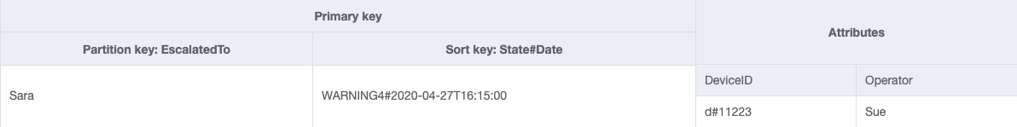
Access Pattern: Fetch all escalated device logs for a given supervisor
GSI-Supervisor
Sparse GSI: Only items that match the GSI index are projected.
Good for: - ‘Needle in the haystack’ - Cost effective ‘scans’ - Item management
Base Table
Notes:
GSI can be added and removed at any time. Let’s say there is a need to look up device updates by a Supervisor… if this were an attribute and indexed on a GSI it would represent a very small % of overall items.
GSIs are sparse – which means that only items that match the GSI’s primary key are copied into the GSI. This can be used for very efficient indexing of select items.

Slide 14
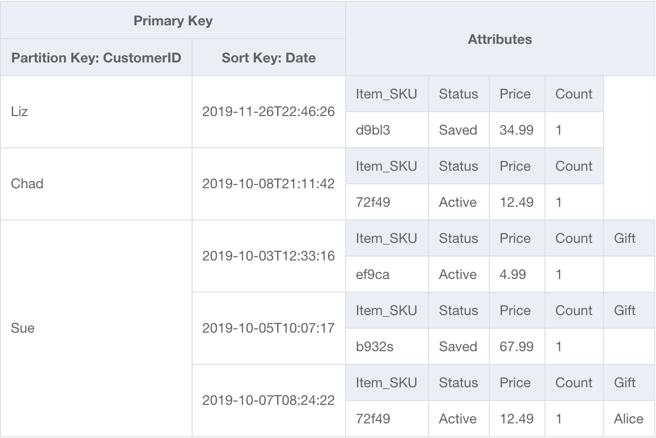
Filter Expressions
App: Retail Cart
Access Pattern: - By: user, date, & status Design Model: - High Cardinality PK - Sorted by Time - Filtered by Status
Returned
SELECT * FROM Table
WHERE CustomerID = ‘Sue'
ORDER BY Date DESC
FILTER ON Status=‘Active'
Filtered
Notes:
→ Hidden: The above Device Filter vs Condition example illustrates this pattern without introducing delete/insert. This retail cart example is more complex, but allows you to discuss the tradeoffs when designing a data model.
<Important note for the presenter: This pattern illustrates composite sort keys, it is important to understand that sort keys are not updated in place, but need to be deleted/inserted. This pattern works well for a workload that is read heavy. You may also consider pushing the composite sort key to a GSI, where it will manage the ”insert/delete” to reduce application logic… This would result in 3 writes (1 to the basetable and 2 on the GSI – a delete and insert) instead of 2 writes (a delete and insert on the base table) so it is less efficient overall – but it does reduce the application side logic. This is important to understand with data model design: there are trade offs at each step. Balancing optimizations and application logic is an important discussion and there can be multiple ways to achieve a goal.>
-----
Warm up data modeling example – to understand the difference between Filters & Sort Key conditions.
This example is of a Retail Cart table, with access patterns what match the user opening the app. For example, a user logs in and:
Retrieve all active items in the cart sorted by recency of when they were put in the cart
Retrieve all items I’ve saved for later, also sorted by time order of recency
Retrieve items which have been shipped.
The table is organized by CustomerID, so it has a well distributed/high cardinality key space and access pattern. (The number of partition keys will scale out as more traffic and throughput is used by the application) It is sorted by Date – so that queries can return items in most recent order. The combination of the ID and the Date define uniqueness – so in this case, there could be a new item inserted each second (this could be more granular).
In this example – the query filters by Status, a non-key attribute. This is applied AFTER the query runs, so if there are 3 items and 2 are returned all 3 are read (and consume read capacity) and one is dropped. This isn’t so bad, but what if there are 500 previously saved items and the first query on log in only wants the 2 active items? The query would read 500 items and drop 498.
So, can we do better?......Yes!

Slide 15
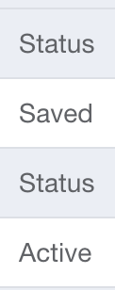
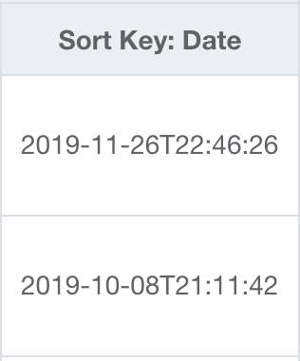
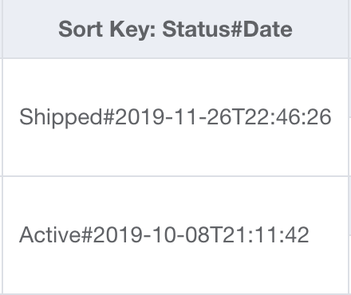
Composite Sort Key: Concatenate general attribute prior to specific attribute
+
=
Notes:
Build composite sort keys by concatenating 2 attributes that you are interested in. Use the most general on the left and concatenate the more unique to the right. This enables the ‘begins_with’ condition we will see in a moment…
In this example – we are interested in Status and Date – the Status is much more general (3 values: Active, Saved, & Shipped), so it is our leading term in this concatenated attribute.

Slide 16
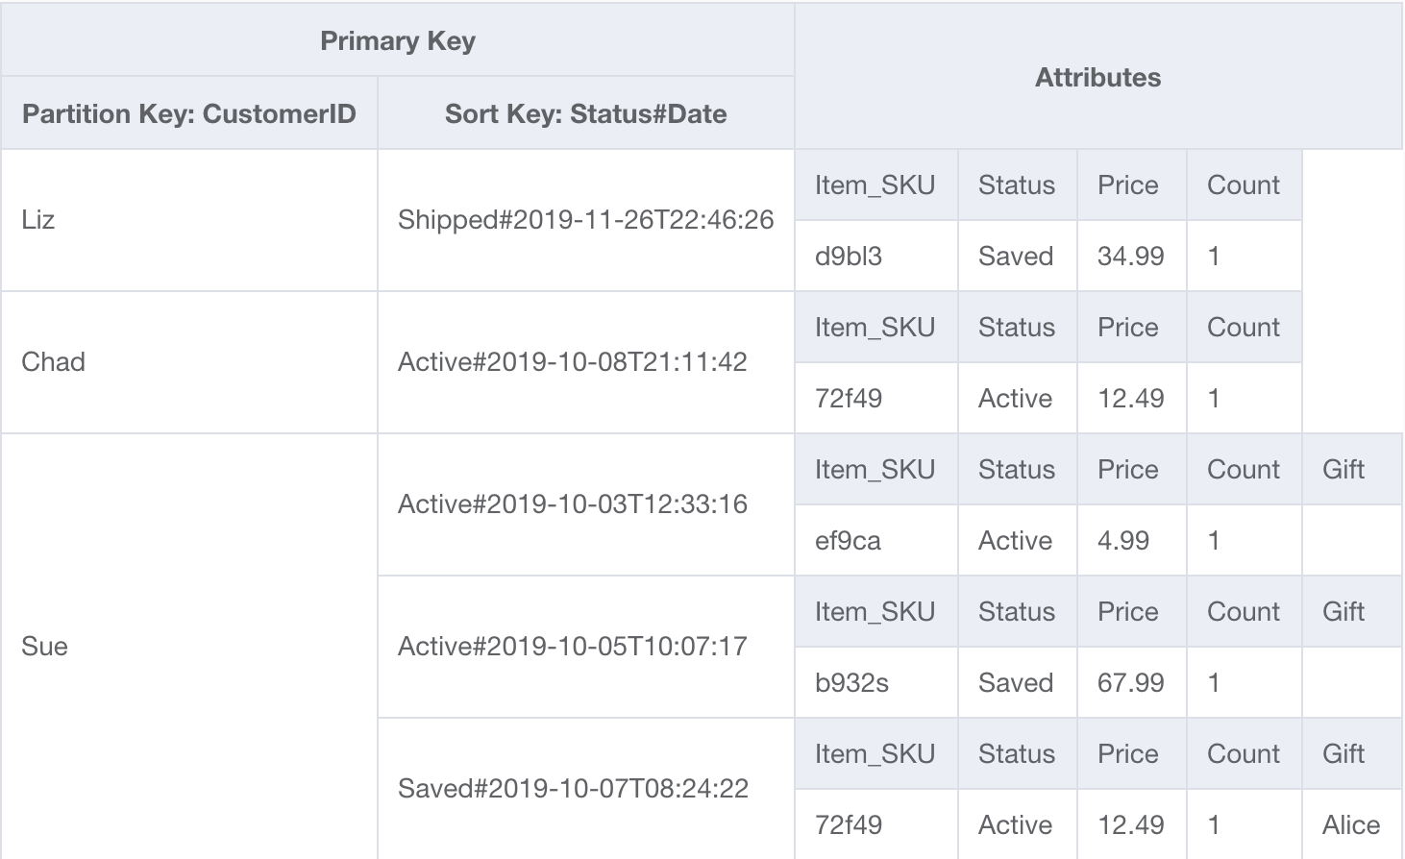
Key Condition Expressions
Status#Date
SELECT * FROM Table
WHERE CustomerID = ‘Sue'
AND Status#Date BEGINS_WITH ‘Active’
ORDER BY Status#Date DESC
Sort key
Returned
Notes:
We now have a new Sort Key – a composite key. The application writes this as the sort key.
This fundamentally changes the query. Now, if there were 500 hundred saved items, and this Begins_With query is run – it will read and return ONLY the two items. This is how we can create very efficient targeted queries.
A couple additional points:
– Queries always need the full equals on the Partition Key.
-- Queries will return all of the items as a single aggregate. So, if there are 10 items that are 400bytes each (4KB) it would still just consume 1 RCU (4KB).
Great – we’ve built a composite sort key to model multiple query access patterns into a single sort key. There could be many more layers to this hierarchy as long as it fulfills the access pattern. This is a solid 1 to Many relationship. 1 customer to many items – and we now can sort it by status and order it by date. This fulfills the common access patterns of the application for the user.

Slide 17
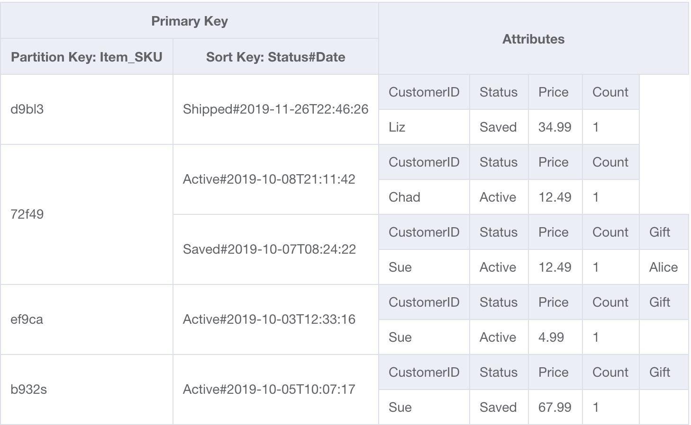
New Access Pattern: Search by Product
Access Pattern: - By: product, date, & status Design Model Change: - N:M model – users:products - GSI Indexed on Item_SKU
Base Table
GSI – Item_SKU
SELECT * FROM GSI Item_SKU
WHERE Item_SKU = ’72f49'
AND Status#Date BETWEEN ‘Active#2019-10-08’ AND
‘Active#2019-10-15’
ORDER BY Status#Date DESC
Notes:
What if we want a new access pattern? What if Marketing comes along as says: we want to see everyone who put an Alexa in their cart last week, but didn’t check out?
We could define a GSI partition key on the Item_SKU from the base table. This will work well, because it also has a high distribution of keys and access. We can reuse that handy Status#Data attribute for the GSI sort key as well.
Items written to the basetable are written into the GSI indexed by the the SKU. It doesn’t matter if there are 100M items in the base table – we can use a highly efficient query on the GSI to return Active items from last week using the “BETWEEN” range.

Slide 18
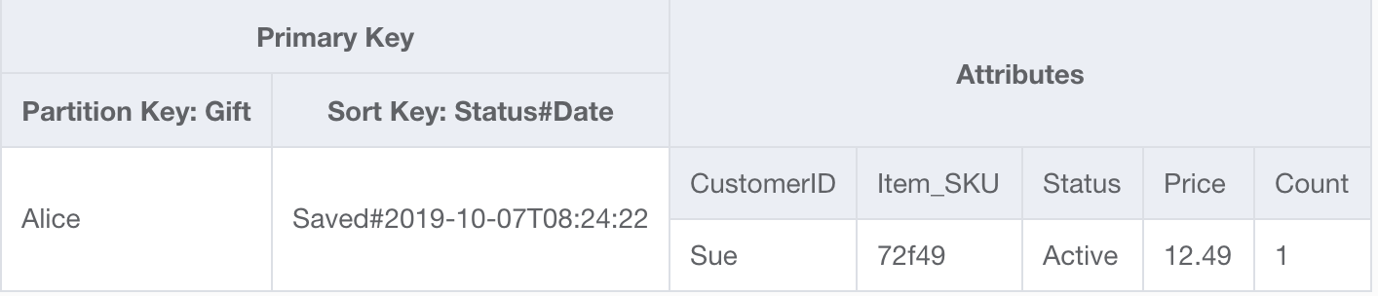
Sparse GSI
Only items that match the GSI index are projected.
Good for: - ‘Needle in the haystack’ - Cost effective ‘scans’ - Item management
Base Table
GSI Gift
Notes:
GSI can be added and removed at any time.
They are also sparse – which means that only items that match the GSI’s primary key are copied into the GSI. This can be used for very efficient indexing of select items.

Slide 19
Take Aways:
Build targeted Queries using composite keys
Start with Sort Key conditions
Supplement with Filter Expressions
Notes:
Building queries means you will write data as you will access it.
We will explored how composite keys are the foundation of building relationships and contrast the Sort Key condition and Query Filters. This technique will be used repeatedly in this session.

Slide 20
Artificial Sharding
Handling low cardinality &
Segmenting the key-space (the magic of sort keys)
Notes:
Let’s take a different view of data model challenges. Artificial Sharding (aka write sharding) – highlights challenges with NoSQL data models and interesting solutions to accessing items.

Slide 21

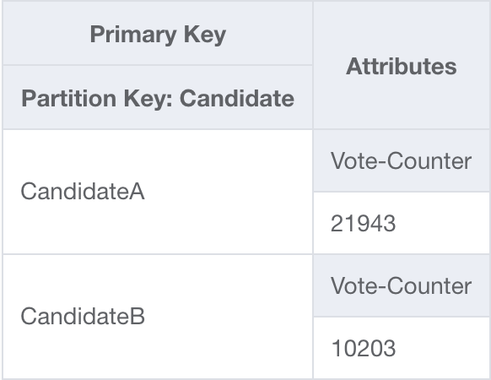


Scaling high write throughput & low cardinality…
Votes Table
Voters
20,000 votes/sec
10,000 votes/sec
Candidate A
Candidate B
Single Item limit: 1,000 WCUs
Notes:
To set the stage for artificial sharding, let’s look at a scenario with where there is low cardinality in the keyspace: Voting
In an election – there is a bounded (and small) number of unique keys. In this case – there are 2 candidates, which are effectively two items. As we know – each item is limited to 1k WCUs – so 19k votes for candidate A and 9k votes for candidate B are rejected.
Even if there were 100 partitions on this table, all the votes would be localized on 2 partitions.
How does artificial sharding help us?

Slide 22
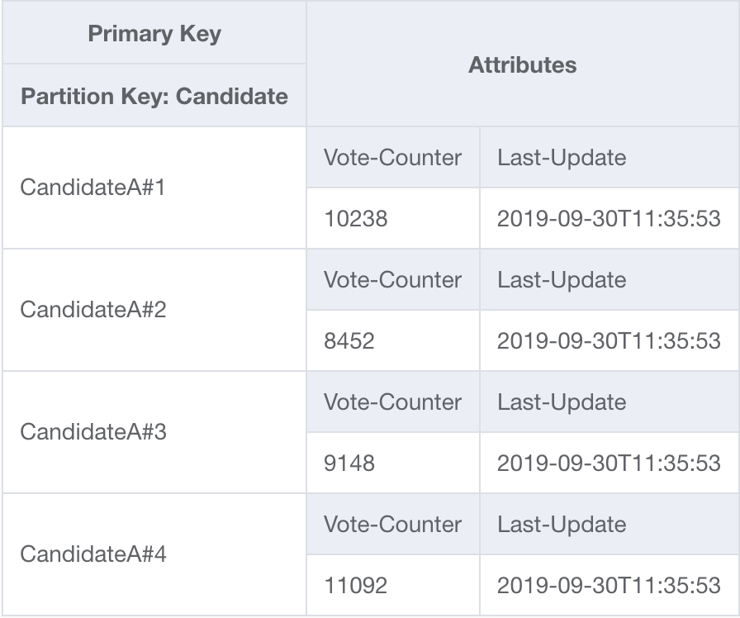
Write shard the partition key…
UPDATE Item : { “CandidateA#”+rand(0,N),
Vote-Counter +1 }
Voters
Candidate A#4
Candidate A#7
Candidate B_4
Candidate B_8
Candidate A#1
Candidate B_1
Candidate B_5
Candidate A#5
Candidate B_3
Candidate B_7
Candidate A#3
Candidate A#2
Candidate A#6
Candidate A#8
Candidate B_2
Candidate B_6
Notes:
On the application side - we can simply concatenate a random number to the partition key of each candidate. This artificially distributes the votes, and writes, over N keys.
This solves those rejected writes that exceeded the single item throughput limit. Now we can scale writes to any throughput by writing across any number of keys.

Slide 23
Even Write Distribution
Voters
CandidateA#1
CandidateA#2
CandidateA#3
CandidateA#4
CandidateA#6
CandidateA#7
CandidateA#8
CandidateB#1
CandidateB#2
Item Throughput = N * 1000 WCUs
Notes:
The write distribution looks much better!

Slide 24
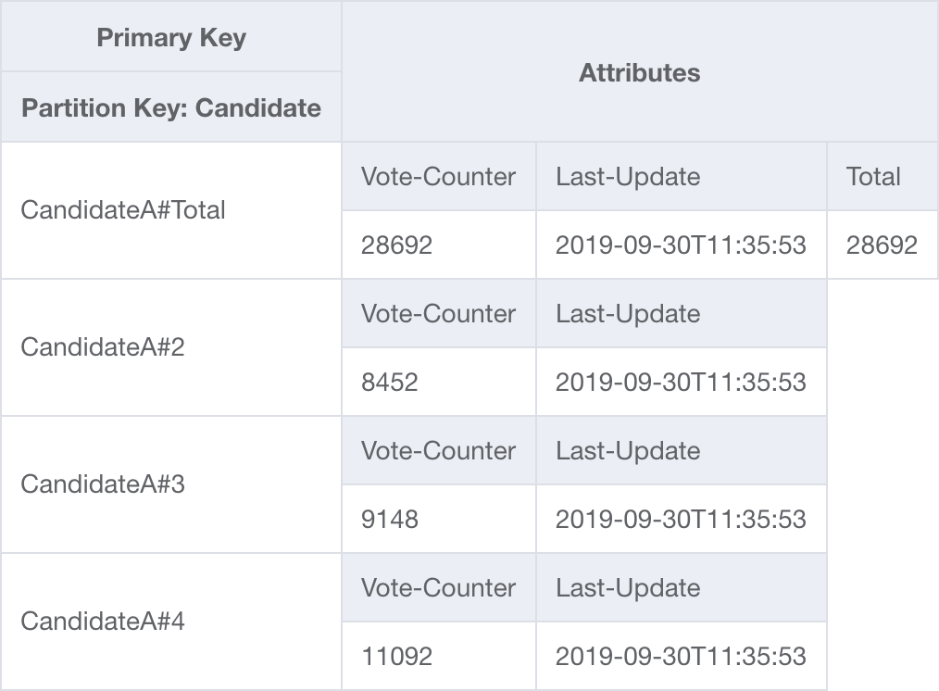

Retrieve result: (in parallel)
3. Retrieve
2. Store
1. Collect
GET: CandidateA#Total
UPDATE: CandidateA#Total + N
Candidate A#4
Candidate A#7
Candidate B_4
Candidate B_8
Candidate A#1
CandidateA#Total
Total: 1.9M
Candidate B_1
Candidate B_5
Candidate A#5
Candidate B_3
Candidate B_7
Candidate A#3
Candidate A#2
Candidate A#6
Candidate A#8
Candidate B_2
Candidate B_6
Notes:
The challenge – is now the votes are spread across N items, how we you count the votes.
Because the application controls N – we know the exact partition key for each shard. That means that it can be retrieved using a BatchGetItem call and retrieve all the candidate shards as a single call!
In the example of a voting application – there could be a Lambda scheduled to retrieve all the values once a second or every couple of seconds. It would then sum all the votes and update a single record. The voting dashboard would do retrievals on this single item.

Slide 25
How many artificial shards? (writes)
100 K * CEILING(ItemSize/1KB) / 1000 =
100
Average item size (i.e 1KB)
Items per second
Partition max WCU
Notes:
The number of shards is determined by the request rate and item size…

Slide 26
Write Shard a GSI
Artificially segment the key space to query the entire table
Notes:
So, the voting example was used to illustrate the mechanism of sharding a key to distribute it across many keys.
This was possible, because the application controlled N… let’s see how to apply this to run arbitrary queries across the entire keyspace.

Slide 27
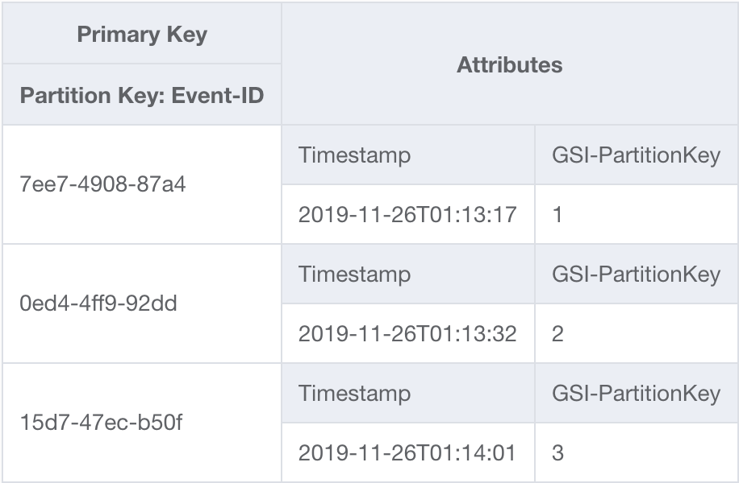
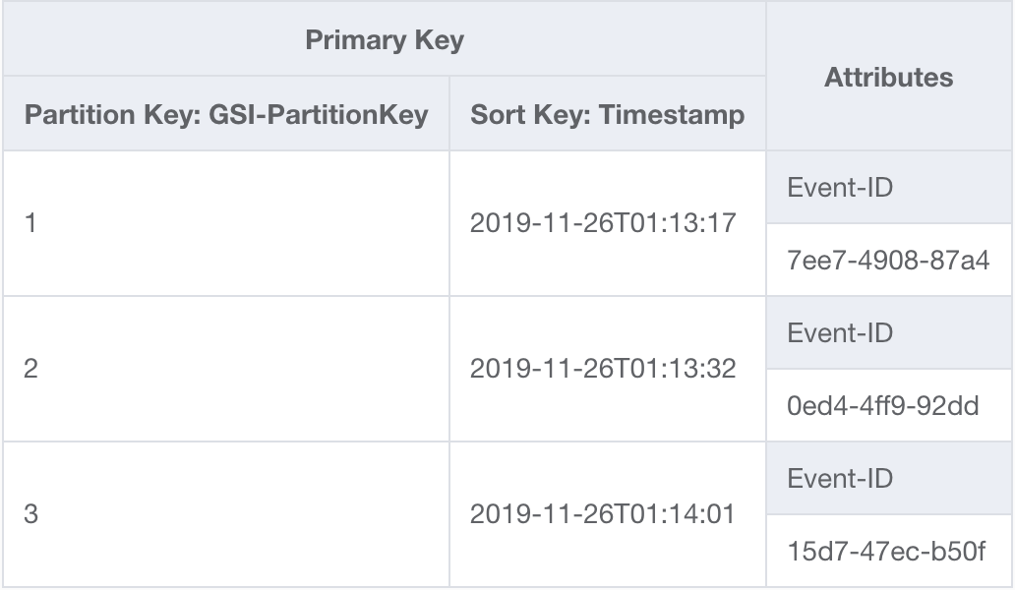


Active Events Table
1. PUT Item = { EventID : UUID,
Timestamp : ISO8601,
GSI-PK : rand(0,N) }
Base Table
Scheduled Lambda
‘Sharded’ GSI
2. Query
SELECT * FROM GSI
WHERE GSI-PK = “<0-N>”
ORDER BY Date DESC
AND GSI-SortKey > “<4 hrs ago>”
Selectively query the entire table..
Notes:
Here is the Scenario: Events – workers → anything older than 4 hours == Alert!
There is an application that tracks events that people are working on. It inserts items in the base table by EventID. However, it needs to alert if an event is older than 4 hours. There is no way to natively query across the whole keyspace to identify any records that are older than 4 hours. That would require a scan – which would read everything in the table.
This application will write an attribute with that same random sharding 0-N. This time – the 0-N is determined by the total throughput of the items written to the GSI. Sharding is application side-it is an attribute in the written item.
Now, if there is a GSI with a partition key on this attribute – we know all the values of N, so we can query directly across the whole keyspace! Instead of scanning every item in the table, we can run a query like:
Select * from GSI
Where GSI-PK = “1”
AND SortKey is > four hours ago.
And repeat for each ‘shard’ – this is a very effective query and could potentially only consume a couple of RCUs relative to how many shards there are. It would also be very performant – returning these results in ms! This approach of artificially segmenting the keyspace and indexing it on a GSI can very useful for arbitrary SQL-like queries, such as keyword search or status.
So – why wouldn’t they just index the table by hour or minute? Time series inserts need special attention, if all inserts for an hour, minute, or even second are performed against the same leading partition key – it will localize all the writes to a single partition. Even if there are hundreds of partitions – at any given moment events would only be written to a single partition.

Slide 28
Time-series data
Common distribution challenge for time-series data
Notes:
Optional Time-Series content….

Slide 29
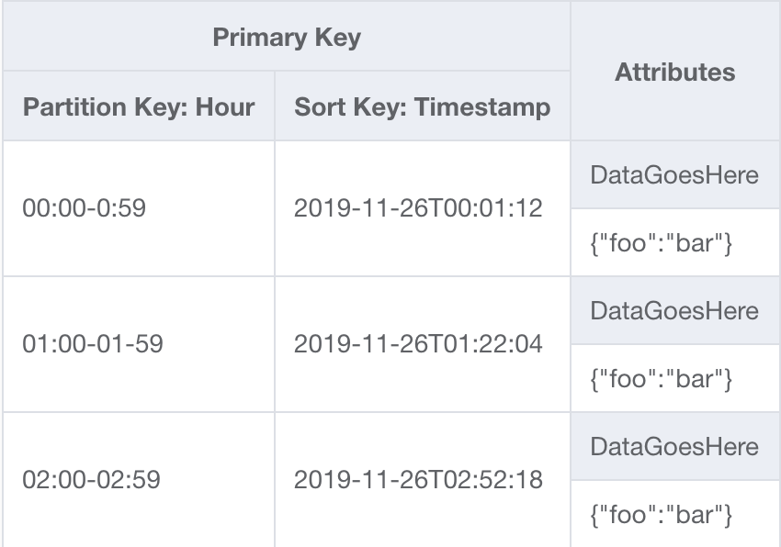

The Challenge of Indexing Time-series Inserts
Localized Writes (by time ‘bucket’)
Application
0:00-0:59
1:00-1:59
…
23:00-23:59
Notes:
Best practices for a horizontally distributed datastore like DynamoDB is that data access should be relatively even over the keyspace…and over time.
If items were inserted into the keyspace by time periods, then ALL the items at any given moment would be inserted into the same localized part of the keyspace.
In a distributed system, this means that even if the table has thousands are of virtual partitions supporting the table only one virtual partition would be actively used to at any given moment.

Slide 30

Time-series two-stage index: optimize queries
Daily Load
Daily Load
AWS Glue
AWS Glue
Sharded Writes (by N ‘segments’)
Optimized Queries (by time ‘segments’)
Daily Table
Long-term Table
Application
Application
parallel reads
distributed writes
1
2
…
N
0:00-0:59
1:00-1:59
…
23:00-23:59
Notes:
This 2-stage pattern to address time series inserts, while also optimizing a long term query pattern can be seen in Uber’s 2019 re:Invent presentation:
“How Uber stores financial transaction in ledgers using Amazon DynamoDB” (https://www.youtube.com/watch?v=iN6mhI5hFt4 )
There is a new base table every day that has N shards as the partition key where items are randomly inserted (the sort key is the time stamp). Every night, this base table is loaded into a long term table where the partition key is a date/time bucket. Because all the data is loaded in parallel it eliminates the bottle neck of the single hot partition key for inserts. Having the long term table also makes the queries efficient – instead of doing N queries and then aggregating/filtering the results – a single query or two can retrieve the exactly the data needed.
This pattern optimizes both ingest and queries…

Slide 31
Artificial Sharding Take Aways:
Distribute low-cardinality write heavy workloads
Shard a GSI to query across the key space
Leverage shards to index time-series inserts
Notes:
The key is that creating a keyspace that you control allows for distributing writes effectively – but also retrieving data efficiently using arbitrary SQL-like queries.

Slide 32
Read Distribution Skew
Product Catalog: Popular item
Notes:
So – we addressed low cardinality writes, or if there were a write-distribution skew, but what about reads?

Slide 33
Read distribution imbalance: “popular items”
Voters
70,000 RPS
Product Catalog Table
Instant Pot
Amazon Echo
…
…
…
…
…
…
Childhood’s End
Item throughput limit = 3,000 RCUs
Notes:
Let’s say that the data set represented a product catalog – where several items receive much more traffic than the rest of the items. This is a very common problem for Amazon.com on Prime Day – everyone wants an instant pot, but nobody wants obscure science fiction.
How do we address this? Sure – we could artificially shard the keys to increase throughput….

Slide 34
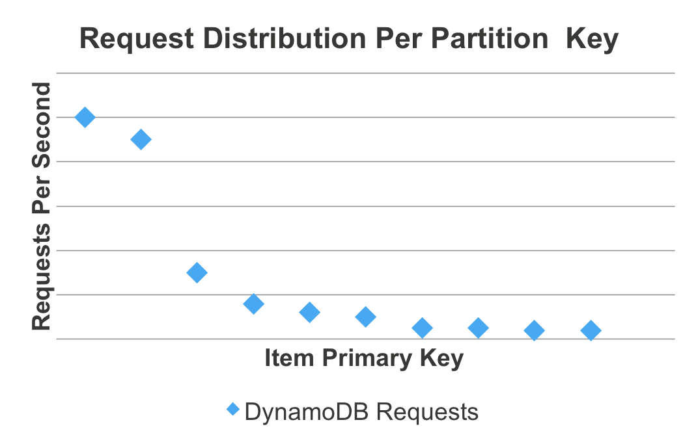
Notes:
This graph illustrates how many requests per second were made for each item in your table. For collections like a product catalog, some items are substantially more popular than others. The same probably goes for tweets sent from a celebrity, and that sort of thing.
Can anyone think of some things that we can do to “cool off” those hot items?

Slide 35

Features
Fully managed, highly available: handles all software management, fault tolerant, replication across multi-AZs within a region
DynamoDB API compatible: seamlessly caches DynamoDB API calls, no application re-writes required
Write-through: DAX handles caching for writes
Flexible: configure DAX for one table or many
Scalable: scales-out to any workload with up to 10 read replicas
Manageability: fully integrated AWS service: Amazon CloudWatch, tagging for DynamoDB, AWS Console
Security: Amazon VPC, AWS IAM, AWS CloudTrail, AWS Organizations
Notes:
Use a cache!
The benefits of DAX:
Latency: Microseconds
Throughput: Millions of RPS for a 3-node (highly available) cluster
Hot-key/cost savings: reduce over provisioning for frequently accessed data
Simplified caching: DynamoDB API, AWS integration
With DAX – it doesn’t matter what the read distribution is – the first request will be sent to the DynamoDB table, but every subsequent request is fulfilled from memory. (potentially even saving cost!)

Slide 36
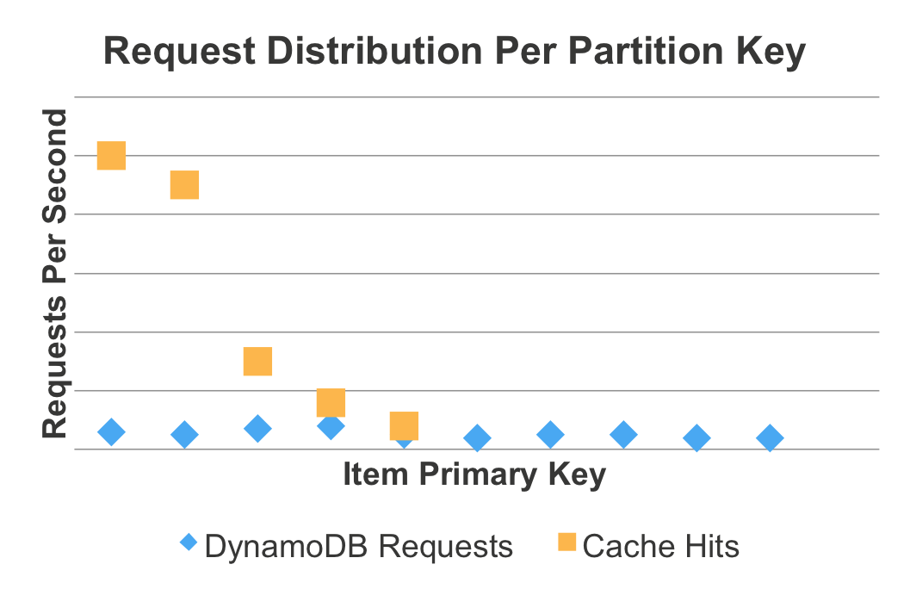
Notes:
With a cache – the read distribution is normalized on the DynamoDB table.

Slide 37
Complex Queries & Analytics
Realtime aggregations
Right tool for the job
Notes:
So, now the we’ve set up some good models for 1:N, M:N, and SQL-like queries in data models-what if we need queries that cannot be easily modeled in a k/v NoSQL database?
Aggregates – like counts or sums are very difficult on a k/v database. It generally requires scanning the whole table, which we want to avoid. Or, what about those 5-10% of queries that are ad hoc? Business Intelligence, Monetization teams, and personalization teams frequently want to run analytics against the hot data in your table… but these are queries that don’t match the data model so they would also requires table scans… How do we solve this?

Slide 38

DynamoDB Streams
Event-Driven Architecture
DynamoDB Streams
Ordered stream of item changes
Exactly once, strictly ordered by key
Highly durable, scalable
24 hour retention
Sub-second latency
Compatible with Kinesis Client Library
Lambda
1
KCL
Worker
Partition A
Partition B
2
KCL
Worker
Partition C
3
KCL
Worker
Updates
Kinesis Client Library
DynamoDB Table
Shards
Consumers
Notes:
Let’s take a look at DynamoDB Streams. Streams are a change log – a message bus that persists for 24 hours, of ever mutation on the table. It delivers the items exactly once in order (by keyspace). There is a one to one partitions supporting a table to shards within a stream, in this sense it is very very similar to Kinesis – however, the items are automatically inserted into the stream from table.
These shards are then consumed using a KCL Worker (there is an adapter for the KCL library called the DynamoDB Adapter for KCL) or natively as a trigger for Lambda!

Slide 39
DynamoDB Streams
Anatomy of a Stream Record
{
'eventID': 'ba0aa41d6f9f2d64f’,
'eventName': 'MODIFY',
'eventVersion': '1.1',
'eventSource': 'aws:dynamodb',
'awsRegion': 'us-east-1',
'dynamodb': {
'ApproximateCreationDateTime’: 1546020023.0,
'NewImage’: {Full map of item goes here}
'SequenceNumber’: '113973700000000001108655351',
'SizeBytes': 116,
'StreamViewType’: 'NEW_AND_OLD_IMAGES'
}, 'eventSourceARN':'arn:aws:ddb:reg:acct:tbl/str/'
}
Sequence number: - Ordered within shard
Record Image Options: - Old/New Images or Keys Only
Type of event
TTL delete: principal = dynamodb
Two consumers per stream
Notes:
This is what a stream record looks like – it is important to note, you have 4 options when turning on streams (and they can be turned on/off at any time).
KEYS_ONLY
NEW_IMAGE
OLD_IMAGE
NEW_AND_OLD_IMAGES
It is also important to see, that items expired by TTL will have a new attribute – indicated that the item was expired by the system.
Streams do not cost anything to turn on, and are very cost effective to read: $.02/100k events read from the stream… or nothing if read from Lambda!

Slide 40




Serverless & Event Driven Architecture
DynamoDB Streams
Data Events
Realtime Aggregations
Elasticsearch
Notify change
Athena
S3 (Parquet)
Kinesis Firehose
Lambda
Notes:
Let’s take a look at how this can be leveraged…
As Lambda reads records for a stream – it can create a realtime aggregation, such as counting how many people add X item to their shopping cart or download Y album from the catalog. This allows for a single item retrieval rather than a scan of the table and subsequent count! This key here is that these aggregates need to be defined up front so they can be built in realtime, but this is a very effective way to handle these requirements.
It is also very common to push full records into Elasticsearch for full text lookup! (something very difficult to achieve on DDB). Another common integration is to push records to Firehose, which will buffer them, partition, and store them on S3 in Parquet. They are then easily accessible for those Business Analytics ad hoc queries!
This is all about using the right tool for the right job…
Regarding Lambda optimization: Set an appropriate batchsize (up to 1k) based on the type of transformation – ie simple copy could be 200 records, or complex diff/analysis maybe only read 20 records. Also ensure it has good error handling – and monitor on the iterator age, which will fall behind if the Lambda function fails (it will retry the same batch of records).

Slide 41


Time-To-Live (TTL)
Time-To-Live
An epoch timestamp marking when an item can be deleted by a background process, without consuming any provisioned capacity
Archive Design Pattern
CustomerActiveOrder
TTL job
OrderId: 1
CustomerId: 1
MyTTL: 1492641900
Amazon Elasticsearch
DynamoDB Table
DynamoDB Streams
Amazon Kinesis
Amazon S3
Notes:
TTL is a item level attribute timestamp in epoch time that designates when item expires.
Does not consume resources! (normal delete operations consume WCUs)
tables -> TTL -> Streams
Common integration: tables → TTL → <principal:DynamoDB> Streams → Archive/Action
Because there is a principal flag for TTL expired items, it is simple to ‘tier out’ cool data from the table into an S3 data lake or archive.

Slide 42
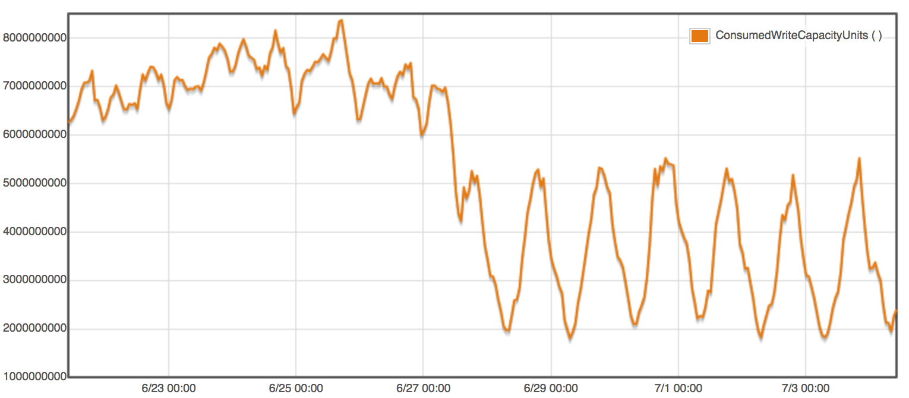
Time-To-Live (TTL)
Enabled TTL on Table
Write Capacity Units
Notes:
Customer was manually deleting expired items. By leveraging TTL – they reduced cost and consumed WCUs by ~30%!
Call out – TTL is lazy, so expirations can take a couple hours. There is a 48hour upper bound of this behavior. Stale items can be easily removed from result sets using the Filter Expression on the epoch time stamp.

Slide 43
Large Items, Vertical Partitioning, & GSI Overloading
Working with large items
Query nested JSON
Future resilient data models
Notes:
Let’s pivot back into building data models.

Slide 44
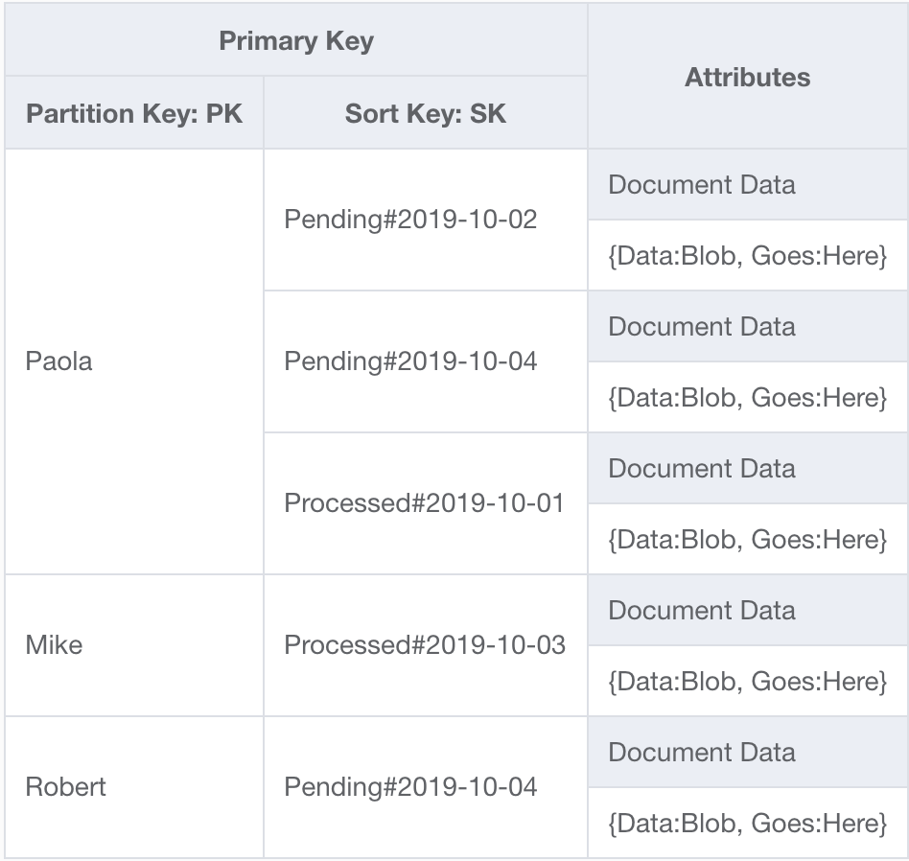
App: Report Processing
Access Pattern: - User Logs in and loads all ‘Pending’ reports - User opens individual reports Dimensions of access: - Average size of 256KB - Owners have ~50 pending reports
50 items × 256 KB each
SELECT * FROM Reports
WHERE User =‘Paola’
AND Sk BEGINS_WITH‘Pending’
LIMIT 50
ORDER BY Date DESC
Notes:
Let’s take an example of a system that serves reports for users to work on. The common access pattern is when a user logs in, then pull a list of reports that they will work on (Status Pending) – which are sorted in order of oldest first.
Let’s take the approach earlier of setting up a composite sort key with Status#Date – you’ll see we are labeling this SK, and the userID is now PK. This is because we can use this index to insert anything – there is no limit to the entities that are indexed, as long as they match the defined data type of the key attributes (String, Number, or Binary).
With this approach – the app can retrieve all pending reports for a user by leveraging the ‘beings with’ sort key condition.
But, if there are 50 items and each one is 256KB each…

Slide 45
Query read consumption
50 * 256KB * (1 RCU / 4 KB) * (1 / 2) = 1600 RCU
Average item size
Eventually consistent reads
Items evaluated by query
Conversion ratio
Notes:
If there are 50 items and each one is 256KB each… it is still a 1,600 RCU read – even as an eventually consistent read! That is a big read for the most common access pattern?
So, how can we modify this to be more efficient?

Slide 46
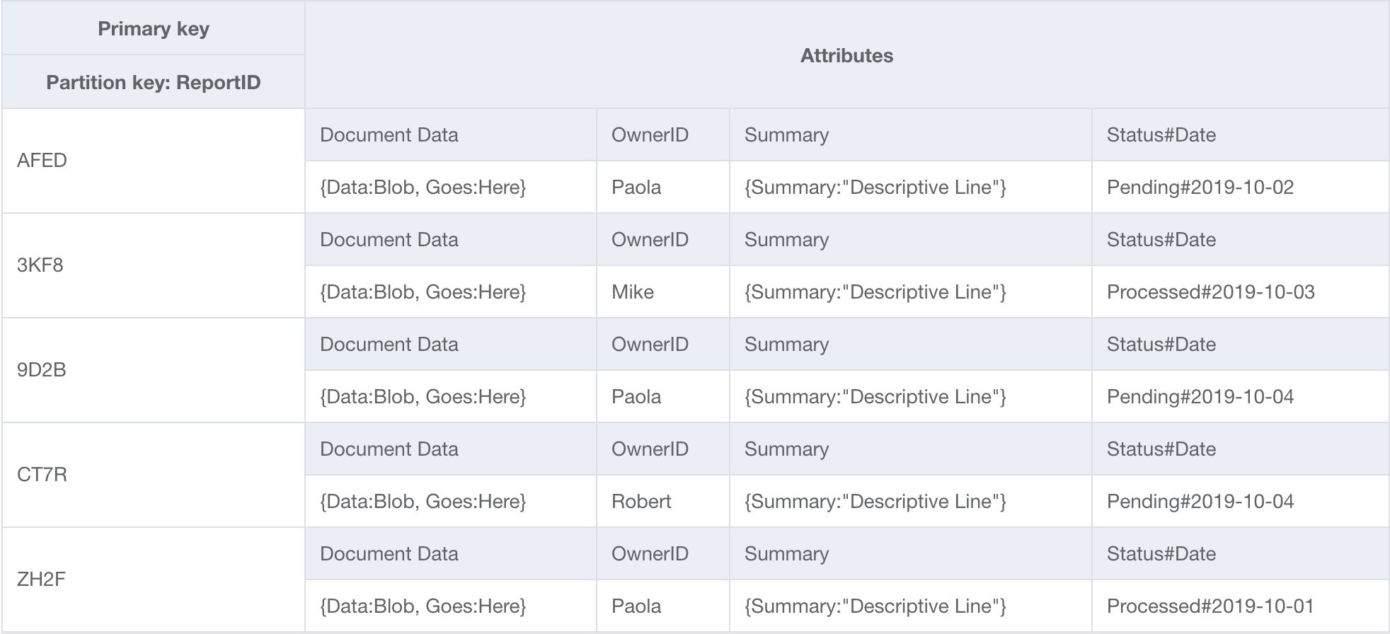
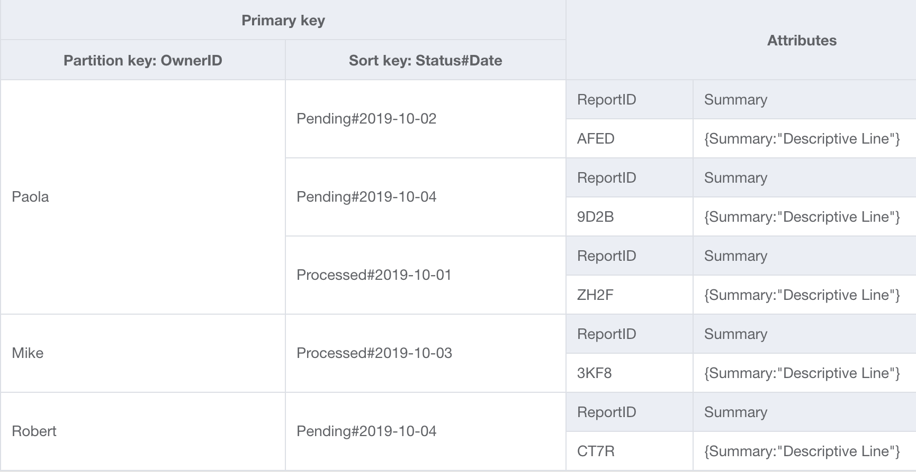
Separate bulk data from frequent access
Redesign: - Order by ReportID - New summary value - New GSI projection - Ordered by OwnerID
Benefits: - Query 50 items = 1 RCU - Access individual reports
SELECT * FROM GSI
WHERE Item_SKU = ‘Paola'
AND Status#Date BEGINS_WITH ‘Pending’
ORDER BY Status#Date DESC
GSI – OwnerID
Notes:
Let’s flip the base table organization – so that records are inserted by their ReportID… without a sort key--there is a single report for each reportID.
When items are written to the base table, we will also create a new attribute – a “Summary” attribute that is a just a couple bytes – like the top line of each report.
We can then set up a GSI and only project the Owner, Status#Date, ReportID, and Summary attributes. Now, when the application pulls a list of 50 pending reports – it is pulling 50 very small items. This can likely be done with less than a single RCU! (Queries treat all the results as a single item aggregate)
Why not use selective query on base table? Such as a Filter Expression or Projection expression? It would still read the whole item from the base table and consume the full item size RCUs

Slide 47
How to query nested JSON
Vertical Partitioning Overloaded GSIs
Future resilient data models

Slide 48
Document Indexing
{
”UserProfile" : {
"FirstName": "Paul",
"LastName": "Atreides",
"DateJoined":"1965-08-01"},
”Store" : {
”store_id": ”STOREUID",
"city": "Los Angeles",
"zip_code":"90029”}
"ShoppingCart" : [
{"Spice":
{ "SKU": "SpiceSKU",
"CategoryID":"FictionalSpice",
"DateAddded " :"2019-06-11"}},
{"EspressoBeans":
{ "SKU": "CaffeineSKU",
"CategoryID":"FOODANDDRINK",
"DateAddded " :"2019-06-10"}}],
"ShippingAddress" : {
"street_address": "1234 Arrakis Dr",
"city": "Los Angeles",
"zip_code":"90029",
"status": "default"}
”OrderHistory#OrderUID" : {
”ProductA": ”SKU_A",
”ProductB": ”SKU_B",
"DateOrdered":”2018-09-28"}
}
Shopping Cart Document Example
Notes:
Complex nested document.
Real world example from a customer who was trying to migrate their Point of Sale backend system from Oracle to DynamoDB. Their first hurdle was large items – they were building these large profile documents over time and they could exceed 400kb. The documents would include User data about their in-store purchases, their online profile, their shipping address, items in the cart, and even previous order history.
A couple challenges:
Items in ddb are limited to 400kb (although easily >90% of workloads use items that are under 10kb!)
They could not query nested attributes (couldn’t index Maps, but could use filter expressions… which would be inefficient)
Even a small update – such as adding an item to the cart, would result in the full item size WCU consumption!
The application has to deal with hundreds of KB overhead on each operation when it only needs a couple KB for a specific operation.
So – how can we solve this?

Slide 49
Vertical Partitioning
Split large items into logical blocks. Build a hierarchy on the SortKey by using the nested values.
Benefits:
Enables direct queries on values with hierarchical complexity.
Optimize reads & writes by breaking up large items
Smaller items improves overall application performance
Open ended index by overloading a GSI = Future Resilient!
Notes:
We can vertically partition that document into logical blocks. Essentially – instead of 1 large item, we can have N number of individual items that match the logical elements that the application is actually operating on at any given moment!
Optimizations due to smaller sizes and more direct changes on only items that need to be modified or read. Application overhead is significantly reduced. Also allows for indexing values…
Let’s see how this works…

Slide 50
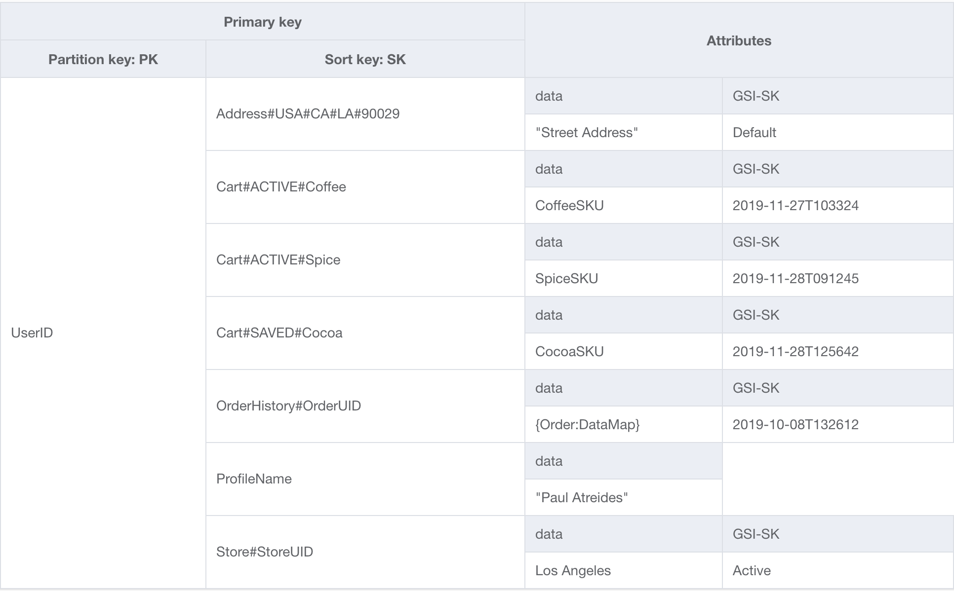
Vertical Partitioning
SELECT * FROM CartTable
WHERE PK =‘UserID'
AND SK BEGINS_WITH ‘Cart#ACTIVE'
Selectively query ‘nested’ attributes
- Optimize object size - Selective Queries - Reduce capacity and cost - Improve App performance - Overload GSI on SK…
© 2017, Amazon Web Services, Inc. or its Affiliates. All rights reserved.
Notes:
Query could still return the ‘Whole Document,” but now it can be targeted: for example – return just the items in the cart, just the profile information, or just the store associated with the user.
It also allows for an open ended data model. If in six months, there is a new feature (Friends of Users) that needs to be built and associate with a UserID – it is as simple as inserting new rows! This is a future resilient data model…
Focus on the labels in the sort key.

Slide 51
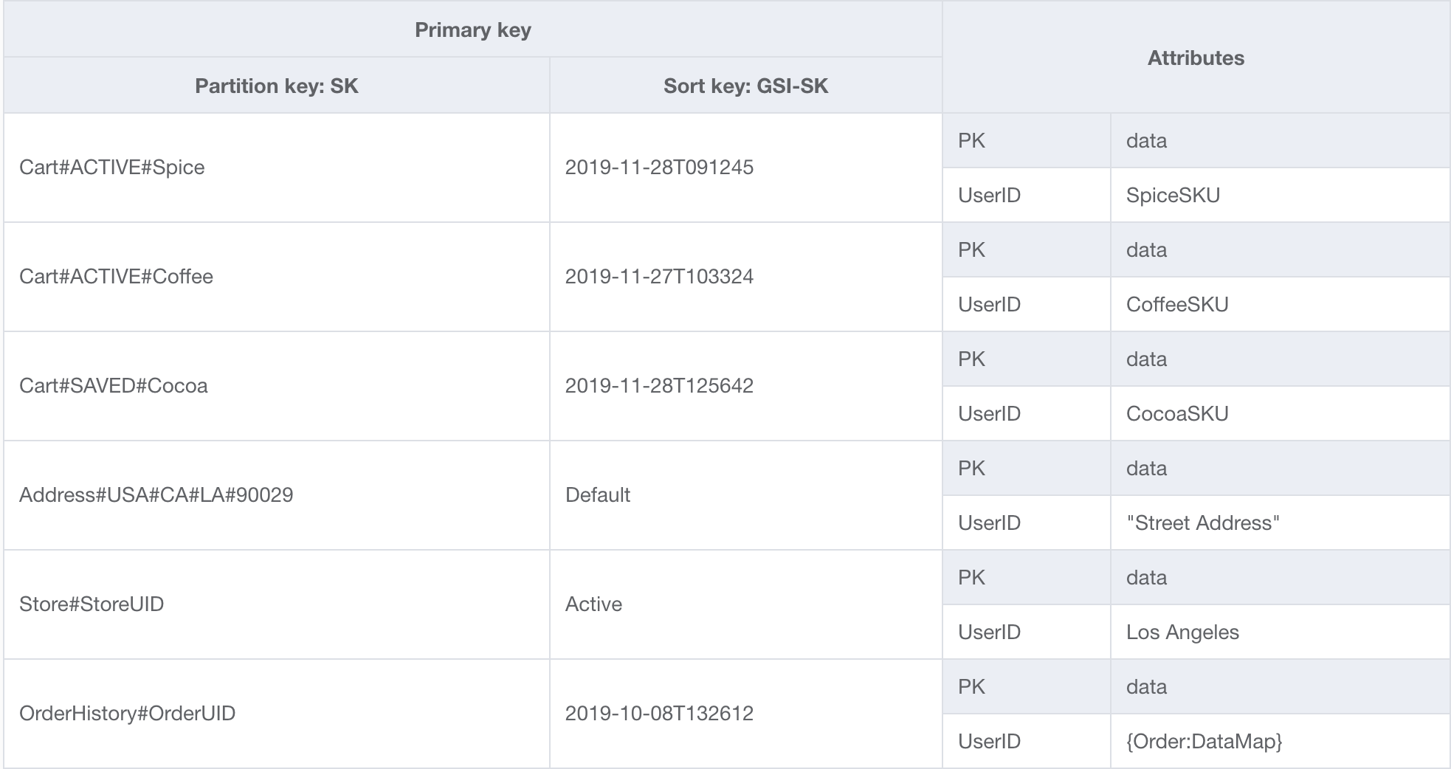
Overloaded GSI
- Index unbounded data: Arrays or Maps - Future Resilient: add new types!!
© 2017, Amazon Web Services, Inc. or its Affiliates. All rights reserved.
Notes:
Further – we can solve for querying across users for nested values… by setting up a GSI. If that GSI is on the sortkey – then it will index all of the associated items. This is an overloaded index.
With this approach, we have solved those challenges:
Items size limitation → Items are now very small – and optimized for each operation. This is going to be a huge consumption saver.
They can query those nested attributes – both specifically for a user, but across users with an overloaded GSI!
The application’s overhead of dealing with large objects is significantly reduced… it now is only working with the item it needs… not a full document!
This is also great for indexing those open ended data types: arrays/maps. It doesn’t matter how many items are in the cart – a single sortkey and GSI can index everything!

Slide 52
GSI approach to querying nested JSON
Write nested values as top level attributes with a GSI.
Benefits:
Enables direct queries on values.
Can create efficient reads using projected attributes
Notes:
Occasionally, there is a requirement to maintain the document in full. There is another approach, were items to be queried are copied as top level attributes.
It is less flexible – but also requires fewer data model modifications.

Slide 53
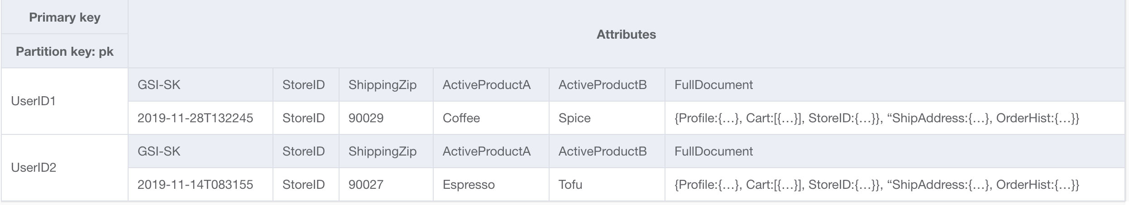
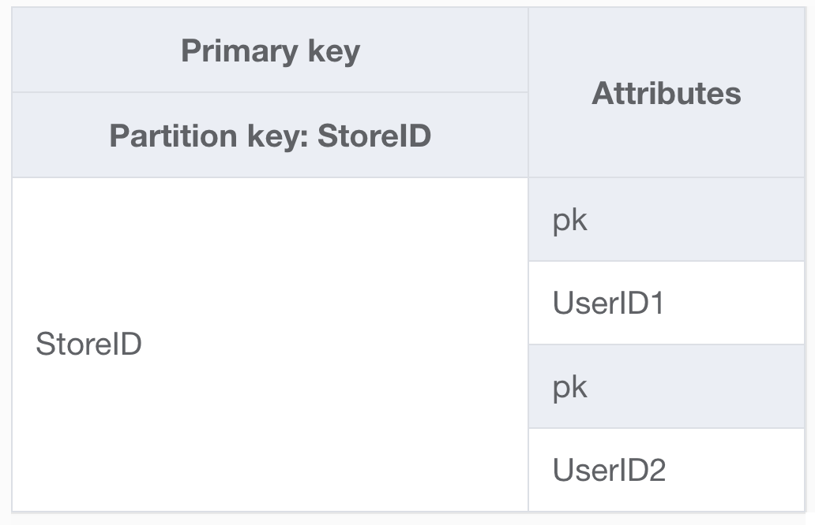
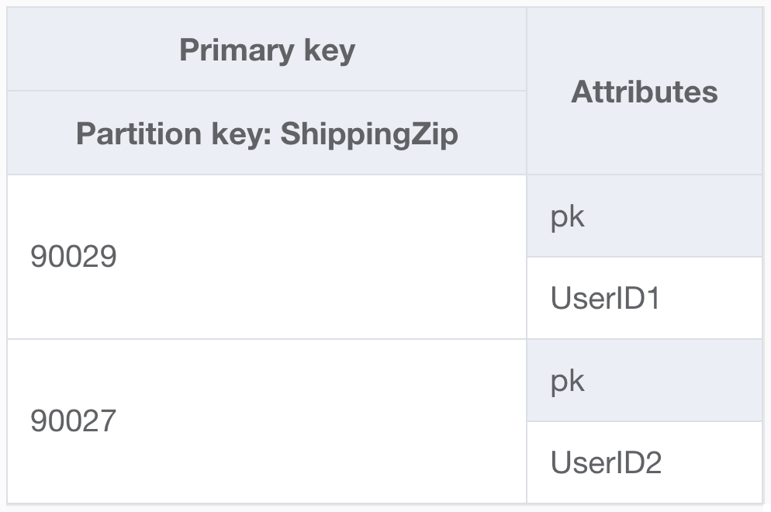
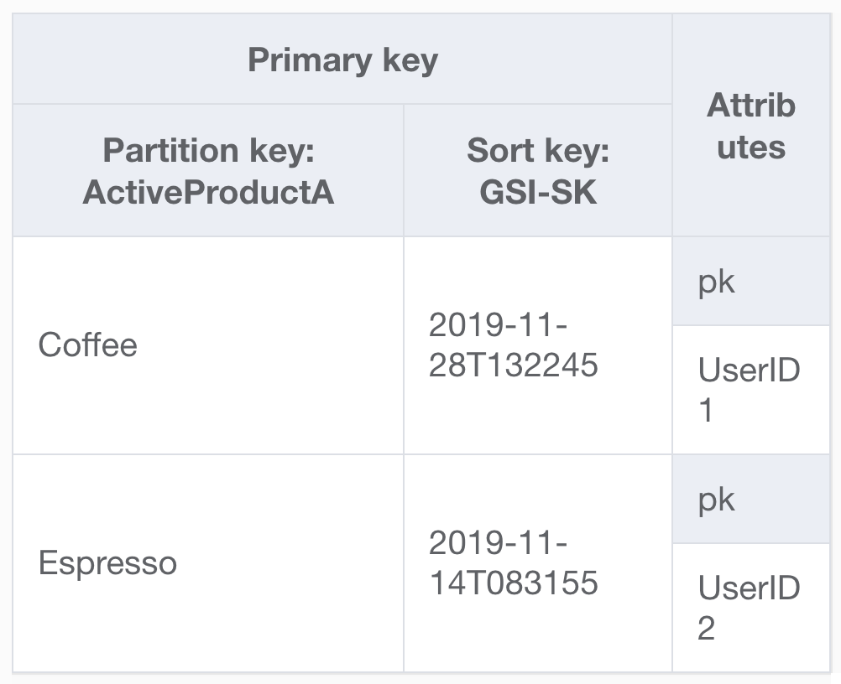
Write top level attributes for indexing
Selectively query specific indexes
GSIs
Notes:
For example – the document is its own attribute and items to be queried are written as their own attributes with GSIs.
This works well for querying across users for ‘StoreID’ or ‘ShippingZipCode,’ but where this doesn’t work well are those open ended data structures…. There is no good way to index an open ended shopping cart using scalar GSI partitions keys…

Slide 54
Take Aways:
Vertical partition to reduce item size
Overload GSI for future resilient data model
Project top level attributes for sparse queries
Notes:
Building queries means you will write data as you will access it.
We will explore how composite keys are the foundation of building relationships and contrast the Sort Key condition and Query Filters.

Slide 55
'Relational’ Data Modeling
Hierarchies & Compound Keys
Transactions
Bringing it all together

Slide 56
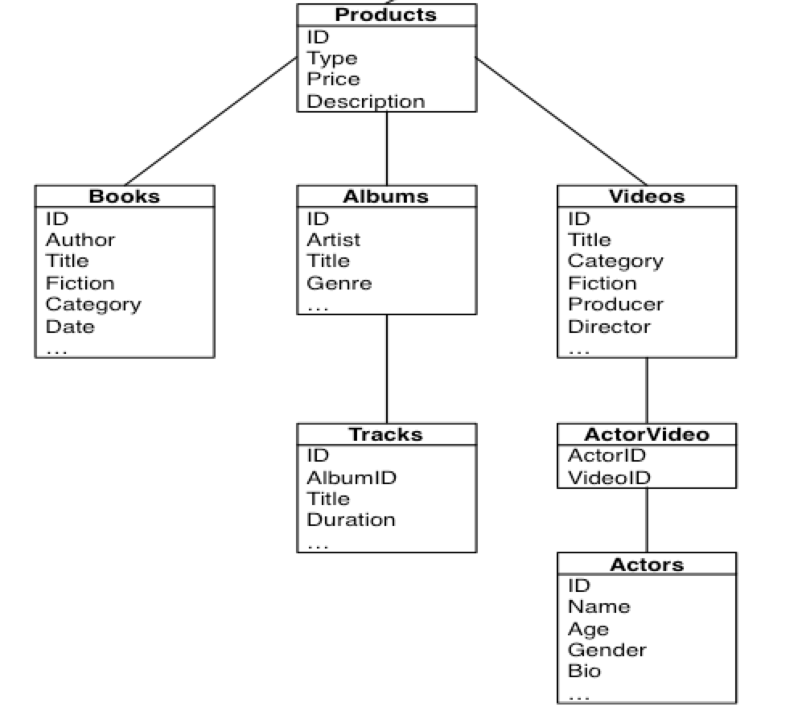
How OLTP apps use data
Mostly hierarchical structures
Entity driven workflows
Data spread across tables
Requires complex queries
Primary driver for ACID

Slide 57
Multi-version concurrency
Distributed Transactions in NoSQL
Notes:
Optional slides for Optimistic Concurrency control…

Slide 58
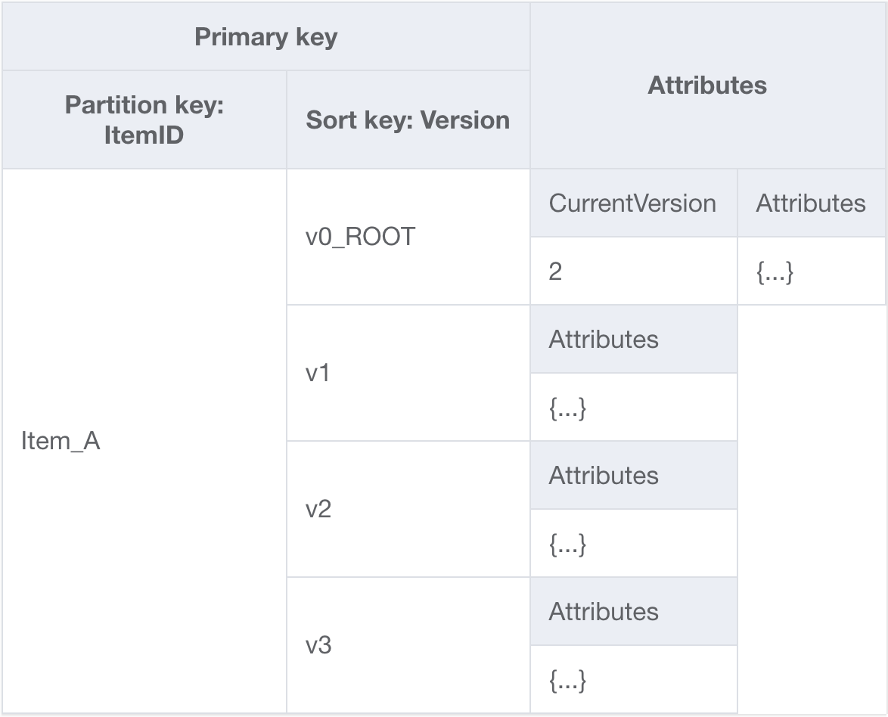
Distributed Transactions & Version History
COPY Item.v0 -> Item1.v3 IF Item.v3 == NULL
UPDATE Item1.v3 SET Attr1 += 1
UPDATE Item1.v3 SET Attr2 = …
UPDATE Item1.v3 SET Attr3 = …
COPY Item1.v3 -> Item1.v0 SET CurVer = 3
Consistency by: - Control current version (ROOT) - Conditionally update ‘CurrentVersion’ - Build version history

Slide 59

DynamoDB Transactions API
TransactWriteItems
Synchronous update, put, delete, and check
Atomic
Up to 25 items within a transaction
Supports multiple tables
Complex conditional checks
Good Use Cases
Commit changes across items
Conditional batch inserts/updates
Bad Use Case
Maintaining normalized data
Notes:
Normalized data structures are a primary driver for ACID requirements. With DynamoDB – many of these requirements are fulfilled simply by storing item aggregates as single rows/items. Each single item operation is ACID (no two operations could partially impact a row simultaneously)
However, DynamoDB introduced Transactions last year, which makes is very simple to ensure consistent changes across related items.
it is an ‘all or nothing’ operation. There is no concept of ‘rolling back’ – the application will not see a partial transaction that is then reverted. Once accepted it will complete, or it will be rejected.
If the tx fails due to condition check failures – there is an option to ‘ReturnValuesOnConditionCheckFailure’ and then rebuild the operation.
There is also an idempotency token for transaction operations to allow for easy idempotency on a distributed system (it ensures that operations will be treated as idempotent for 15minutes)
Let’s see how this works….

Slide 60
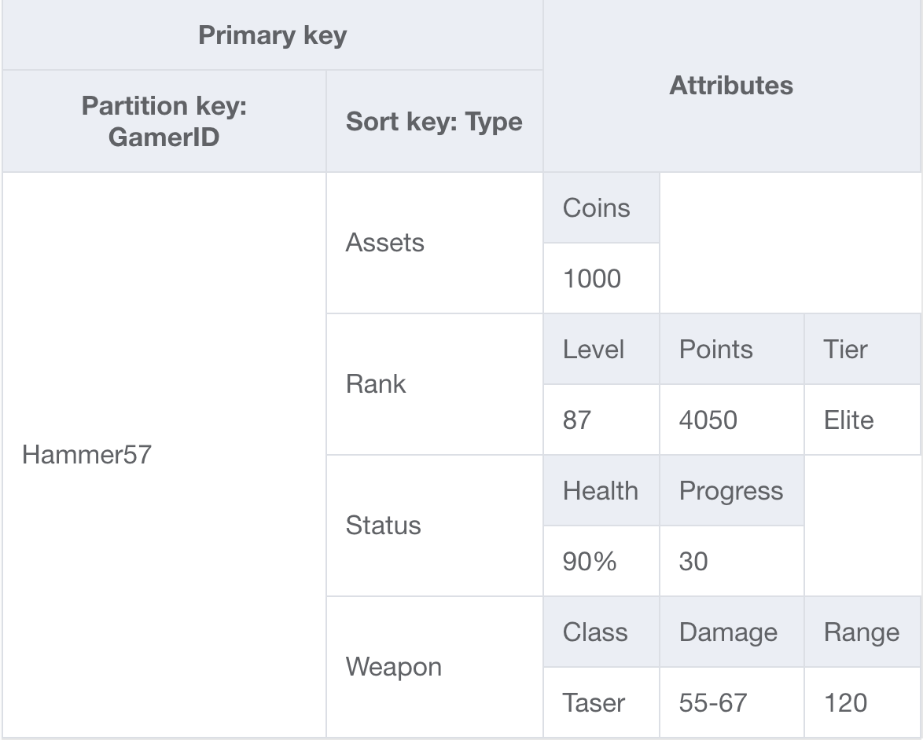
Game state - Transactions API
Atomic update of gamer “Hammer57’s” Health & Coins
{ "TransactItems" : [ {
"Update ": { "TableName": "Gamers", ”Key" :{"GamerTag" : {"S": "Hammer57"}, "Type" : {"S" : "Status"}}, "UpdateExpression" : "Set health = :nhealth", "ExpressionAttributeValues":{":nhealth":{“N”:“100”}} }, { "Update ": { "TableName": "Gamers", ”Key" :{"GamerTag" : {"S": "Hammer57"}, "Type" : {"S" : "Assets"} }, "ConditionExpression" : "coins > :cost", "UpdateExpression" : "Set coins = coins - :cost", "ExpressionAttributeValues" :{":cost":{“N”:“400”}} }
}]
}
Notes:
Here is a table that tracks gamer’s profiles – it is nicely vertically partitioned and organized by GamerID.
In this example – when health is purchased there are three simultaneous requirements; - There are 400 coins to purchase health
Set the health to 100%
Decrement the coins by the cost (400)
These will all happen simultaneously. This could be more complex – and include up to 25 items, perhaps the 400 coins are added to the inventory of the healer? Or, it check to ensure that health is not already equal to 100%.
….

Slide 61
Hierarchical data example
Composite key modeling
Notes:
Many relational models are simple hierarchies… let’s revisit the composite sort key building….

Slide 62
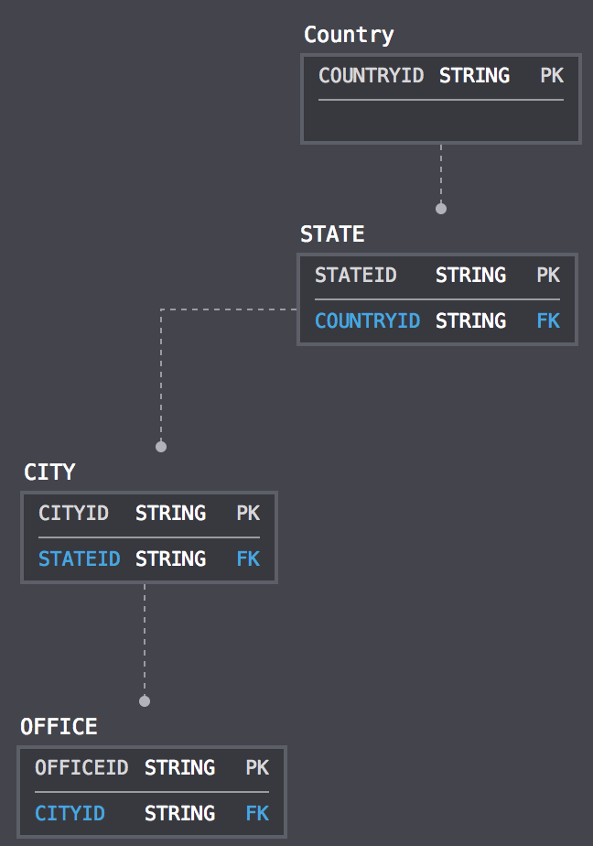
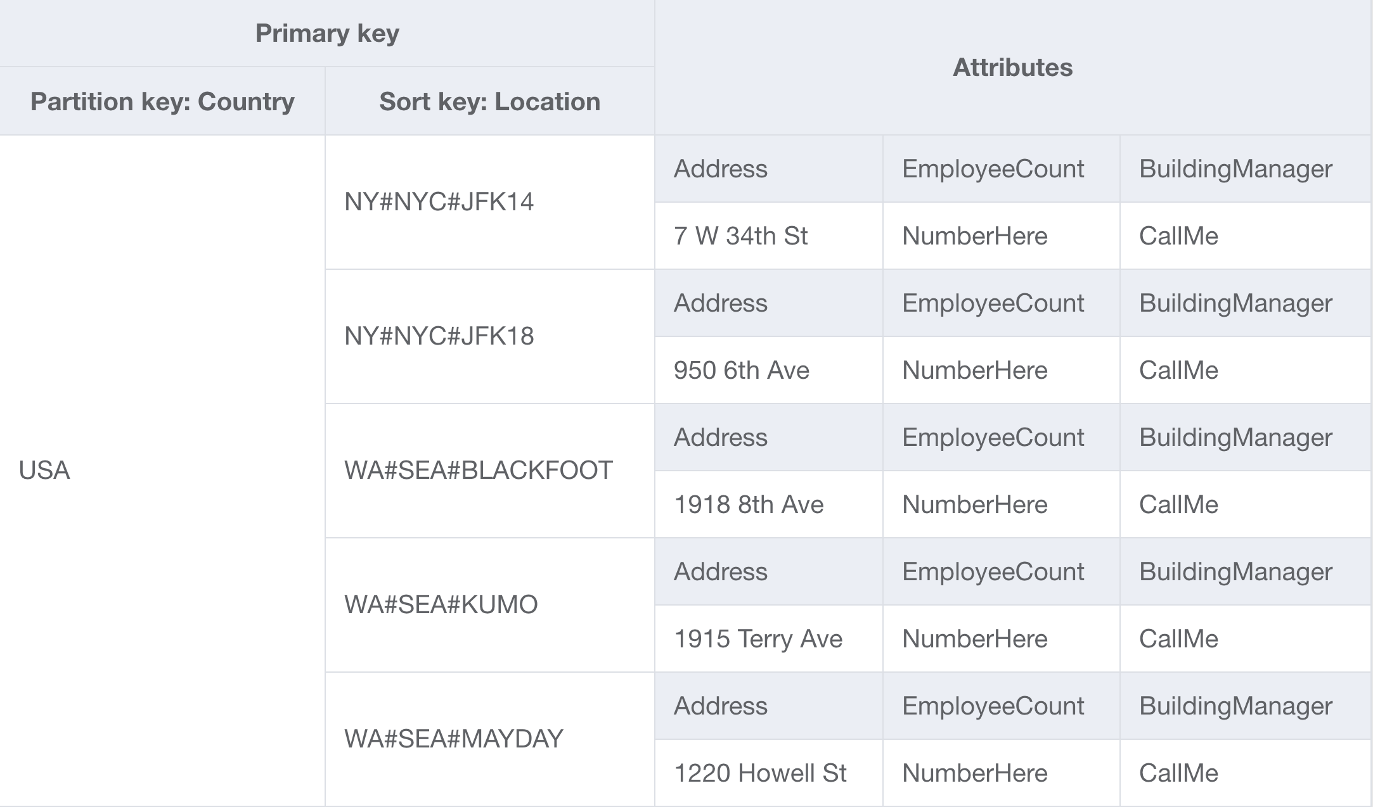
Hierarchical data structures as items
Use composite sort key to define a hierarchy
Highly selective queries with sort conditions
Reduce query complexity
Notes:
This is an example of Amazon’s internal phone tool – it has a hiearchary built on the sort key. For example – this can leverage that begins_with operator to retrieve targeted levels of items:
Give me all the offices in NY
Give me all the offices in NYC
Maybe you build specific floor details into this… Give me all the floors in JFK14
However, can anyone tell me why this is would not make a good data model for an application that was exposed to external users? (unbounded traffic)
….
…
Using something like Country for partition key is not good distribution – it is also very bounded. There are > 200 countries in the world. The traffic associated with them is very very different – Amazon has many more employees and offices in the USA than somewhere like Madagascar. How could you remodel this? Pull up more granularity from the sort key into the PK, for example: USA#NY#NYC – or use GEO-hashing to evenly distribute tiles of offices to partition keys.

Slide 63
Recap – what did we cover?
Tenets of NoSQL Data Modeling
Work backwards from workload dimensions.
Design Patterns
Key Conditions & Filter Expressions
Artificial Sharding & Key Space Segmentation
Vertical Partitions & GSI Overloading
Distributed Concurrency and Transactions
Aggregate Queries and Analytics
Complex Relationship Modeling
DynamoDB in the AWS Ecosystem

Slide 64
Thank you!
userID@amazon.com

